Slide 1

D'LIGHT BIKES
BIKE SALES REPORT
April, 2025
SANNI NURUDEEN AKOREDE

Slide 2



D'LIGHT BIKES
INTRODUCTION
Welcome to our Sales Report Presentation. Today, we delve into a comprehensive overview of our sales performance, exploring the highs, challenges, and strategic insights that have shaped our journey. This presentation is more than just numbers, it's a narrative of our collective efforts, showcasing the impact of our sales strategies and the pathways to future success.

Slide 3
D'LIGHT BIKES
AGENDA
01
06
Statement of Problem
Recommendation
02
07
Objectives
Project Limitation
03
08
Customer Demography
Conclusion
04
09
Project Process
The Dashboard
05
Key Solution / Benefits Of The Findings

Slide 4
D'LIGHT BIKES
STATEMENT OF PROBLEM
Despite the growing emphasis on sustainable transportation and heathy lifestyles, the overall bike ownership rate across different regions remains below average of the entire sample size. This indicates a potential gap in understanding the key drivers that influence customers’ decisions to purchase bike.

Slide 5

D'LIGHT BIKES
OBJECTIVES
The objective of this study is to identify and analyze the factors that significantly impact the decision-making process of potential bike buyers across various regions. By uncovering these insights, stakeholders such as manufacturers, retailers, and urban planners can design more targeted strategies to encourage bike adoption to contribute to the rate of bike positively, reduce traffic congestion, and improved environmental incomes.

Slide 6
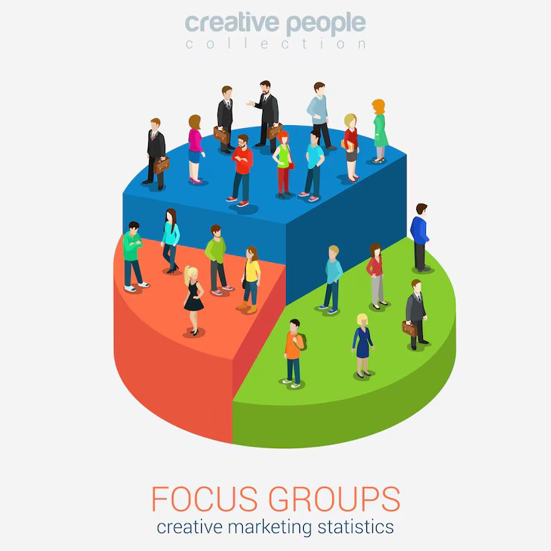
D'LIGHT BIKES
PROJECT PROCESS
The following processes were carried out during the process of the analysis;
·Data Cleaning; some various data validations were done to ensure the quality of the data to be analyzed/visualized, such as; ensuring there are duplicate values, ensuring consistency/integrity of data values, as well as finding out the number of missing values in the data set.
·The next slide explains what was done to sort the missing values discovered.

Slide 7
D'LIGHT BIKES
CUSTOMER DEMOGRAPHY
Code of Conduct
Geographic Distribution
Our customer base spans various age groups, with a significant portion falling within the middle age (adults) range, indicating a strong appeal to the middle-aged demographic.
Geographically, our customers are distributed across 3 Major Regions (Europe, North America, and Pacific), highlighting our reach and effectiveness in diverse markets.
Educational Influence
Commute Distance
Our customer is diversified across educational level, with a substantial proportion among the Partial College.
Analyzing our customers commute distance with respect to their occupation, Cinica Staffs cover the least distance of 0-1 Miles, and the Professionas cover above 10 Mies the most, this could contribute to their choices of getting a bike

Slide 8



D'LIGHT BIKES
SALES PERFORMANCE
Revenue Growth
Market Penetration
Customer Retention
Our sales efforts have yielded a commendable 65% increase in revenue compared to the previous period, showcasing robust growth in product/service sales.
Successful market penetration has been achieved in some specific market segments, demonstrating our ability to capture new opportunities and expand our customer base.
Our focus on customer satisfaction and relationship-building is evident in a 55% increase in customer retention, underlining our commitment to long-term partnerships and loyalty.

Slide 9

D'LIGHT BIKES
PROJECT LIMITATION
01
Binary Outcome Simplification
The purchased bike field is binary. This may oversimplify the decision-making process (e.g; intent to purchase, past ownership, or interest without purchase are not captured.
02
Missing Seasonal Context.
Without date, or time-series data, it’s hard to identify trends over time, seasonality, or impact of specific events.
03
Limited Behavioural Data
The dataset, despite having demographic data, lacks in-depth transactional data, or even detailed behavioral insights (e.g, motivation, satisfaction, reasons for not purchasing, and so on.)

Slide 10
D'LIGHT BIKES
RECOMMENDATION
01
Focus on Regions With Low Purchase Rates
After discovering that certain regions show lower bike purchase rate, the company should collaborate with local governments to improve biking infrastructure, and safety. Launch regional campaigns to raise awareness of biking benefits and provide incentives
02
Promote Biking As a Commute Option
Individuals with commute distances under 5 miles are more likely to purchase bikes. We can create campaigns that position biking as a cost-effective and healthy alternative to car commutes. Partner with employers to offer bike-to-work programs and community perks
03
Leverage Family-Oriented Products and Campaigns
Having households with children showing potential as bike buyers, bunde bike packages, or offer promotions on kids bikes when parent purchase adult models. Emphasize family health, bonding,and weekend recreation in promotions.

Slide 11
D'LIGHT BIKES
CONCLUSION
01
Target Audience Refinement
Our campaign strategy prioritizes a more refined understanding of our target audience. We aim to ensure a more personalized and impactful approach by leveraging data analytics and customer insights.
02
Multichannel Engagement
To maximize reach, our campaigns will span across various channels, including social media, email marketing, and targeted online advertising.
03
Influencer Collaborations
Partnering with influencers who align with our brand values will be a key element of our strategy. Their authentic endorsements can significantly impact audience perception.

Slide 12
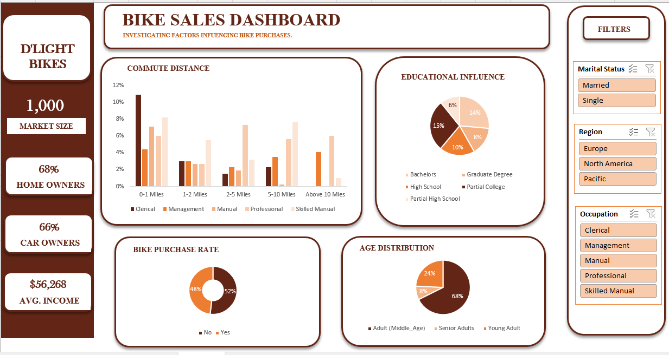
D'LIGHT BIKES
THE DASHBOARD

Slide 13
D'LIGHT BIKES
THANK YOU
April, 2025

